Slide 1
Introduction to Chaincode Development
Blockchain Unchained

Slide 2
Smart Contracts Overview 1
Defines conditions under which transactions are valid
Consist of code and data
“Chaincode” is the term used to describe a smart contract in Hyperledger

Slide 3
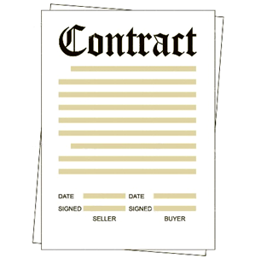
Smart contracts Overview 2
Used to define Trusted participant (roles), e.g.
a) Manufacturer
b) Dealer
c) Lease Company
d) Regulator etc
Used to define a Vehicle (in the Car Leasing demo)
a) VIN
b) Owner details
c) Registration
d) Make
e) Model
f) Scrapped Status
Where Logs are defined. Examples:
a) Create Vehicle
b) Transfer Vehicle
c) Update Vehicle
d) Scrap Vehicle
Restricts “who” can do “what”
Notes:
In the first version of the IBM Blockchain Asset Transfer Demo, the Fabric used to construct the demo does not have any “Member Services” feature. For example there was no way of defining a role for a user or to restrict what that user could do within the demo.
The IBM Blockchain Asset Transfer Demo uses a Smart Contract to assign Accounts used in the demo to have specific roles and in turn define what the Account was allowed to do in terms of business logic. So for example a Manufacturer can transfer a vehicle to a Dealer, but not directly to a Lease Company.
A second Smart Contract is used within the demo to define a Vehicle. Attributes of a “Vehicle Template” for example the assumption is made that all vehicles have a VIN, Owner, Registration Plate, Make and Model. An additional field is also implemented to indicate if a vehicle is scrapped. Each vehicle in the demo is represented using an instance of the “Vehicle Template” Smart Contract. When you transfer a vehicle in the demo you change the specific instance of the “Vehicle Template”.
The “Vehicle Template” Smart Contract is the place where “logs” are defined and coded. Examples include Create, Transfer, Update and Scap.

Slide 4
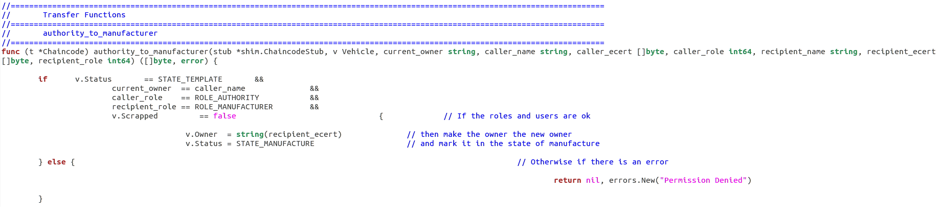
Example of What Chaincode looks like
Code shows the smart contract checking if:
Owner = originator making the call
Caller is an authority
Recipient has to be the correct role (manufacturer)
Car is not scrapped

Slide 5
Go Overview
Chaincode is currently written in GoLang
Other languages are expected to be added over time
Go is an open source programming language that makes it easy to build simple, reliable, and efficient software.
Available for Windows, Linux and Mac
Download from https://golang.org/dl/
Some quotes about Go
“Simple, minimal syntax”
“Garbage collection built-in”
“A flexible interface system”
“Easy concurrency support via goroutines”
“Fast compilation times”
“Simple compile build/run procedures”
“Statically linked binaries that are simple to deploy”
“Fun to write, fast to run”
“Go is familiar to most developers making on-boarding easier.”
“Go is, in essence, a perfected version of C”

Slide 6
Deploying Chaincode to Bluemix
The Blockchain service currently requires chaincode to be in a GitHub repository.
In order to deploy chaincode through the REST interface, you will need to have the chaincode stored in a public git repository.
When you send a deploy request to a peer, you send it the url to your chaincode repository, as well as the parameters necessary to initialize the chaincode.
Before you deploy the code, make sure it builds locally!
{
"jsonrpc": "2.0",
"method": "deploy",
"params": {
"type": 1,
"chaincodeID": {
"path": "https://github.com/ibm-blockchain/learn-chaincode/finished"
},
"ctorMsg": {
"function": "init",
"args": [
"hi there"
]
},
"secureContext": "user_type1_xxxxxxxxx"
},
"id": 1
}

Slide 7
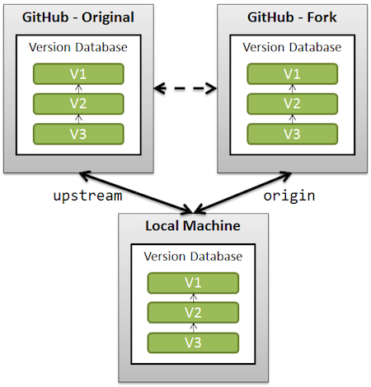
GitHub Workflow
“GitHub is how people build software. With a community of more than 15 million people, developers can discover, use, and contribute to over 38 million projects using a powerful collaborative development workflow.”
https://github.com/hyperledger/fabric
https://github.com/IBM-Blockchain/learn-chaincode
Notes:
You “clone” the original or a fork to your local machine

Slide 8
Recommended Practices to Avoided to prevent Malfunctioning or Non-Deterministic Code
• Iterating using GetRows • Using associative arrays with iteration (the order is randomized in Go) • Reading list of items from KVS table (the order is not guaranteed). Use ordering • Writing thread-unsafe chaincode where invoke and query may be called in parallel • Substituting global memory or cache storage for ledger state variables in the chaincode • Accessing external services (e.g. databases) directly from the chaincode • Using libraries or globabl variables that could introduce non-determinism (e.g. “random” or “time”) • For templates of deterministic and properly-written chaincode, see the examples library. This directory contains samples written in Go and Java.

Slide 9
Now get hands on in Lab 3

